Slide 1

Rebalancing a Retirement Portfolio
New Canaan Mens Investment Club
Paul A. Strassmann, March 5, 2017

Slide 2
Findings
Rebalance portfolio before recession occurs.
Indicators can partially predict recessions.

Slide 3
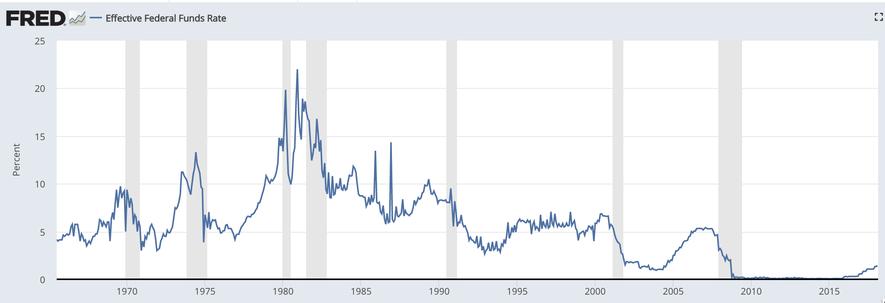
Federal Funds Interest Rate is Cyclical and Anticipates Recession
Recession
Recession
Recession
Recession
Recession
Recession
Recession
Recession
Recession
Recession

Slide 4
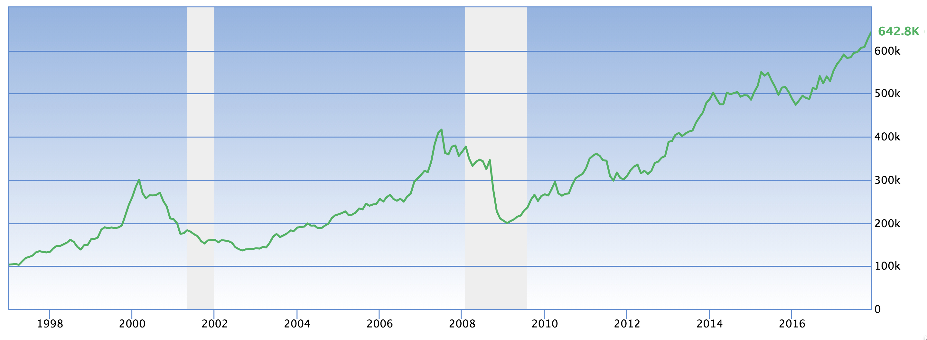
Investor Margin Debt Indicates Possible Recession
Recession
Recession

Slide 5
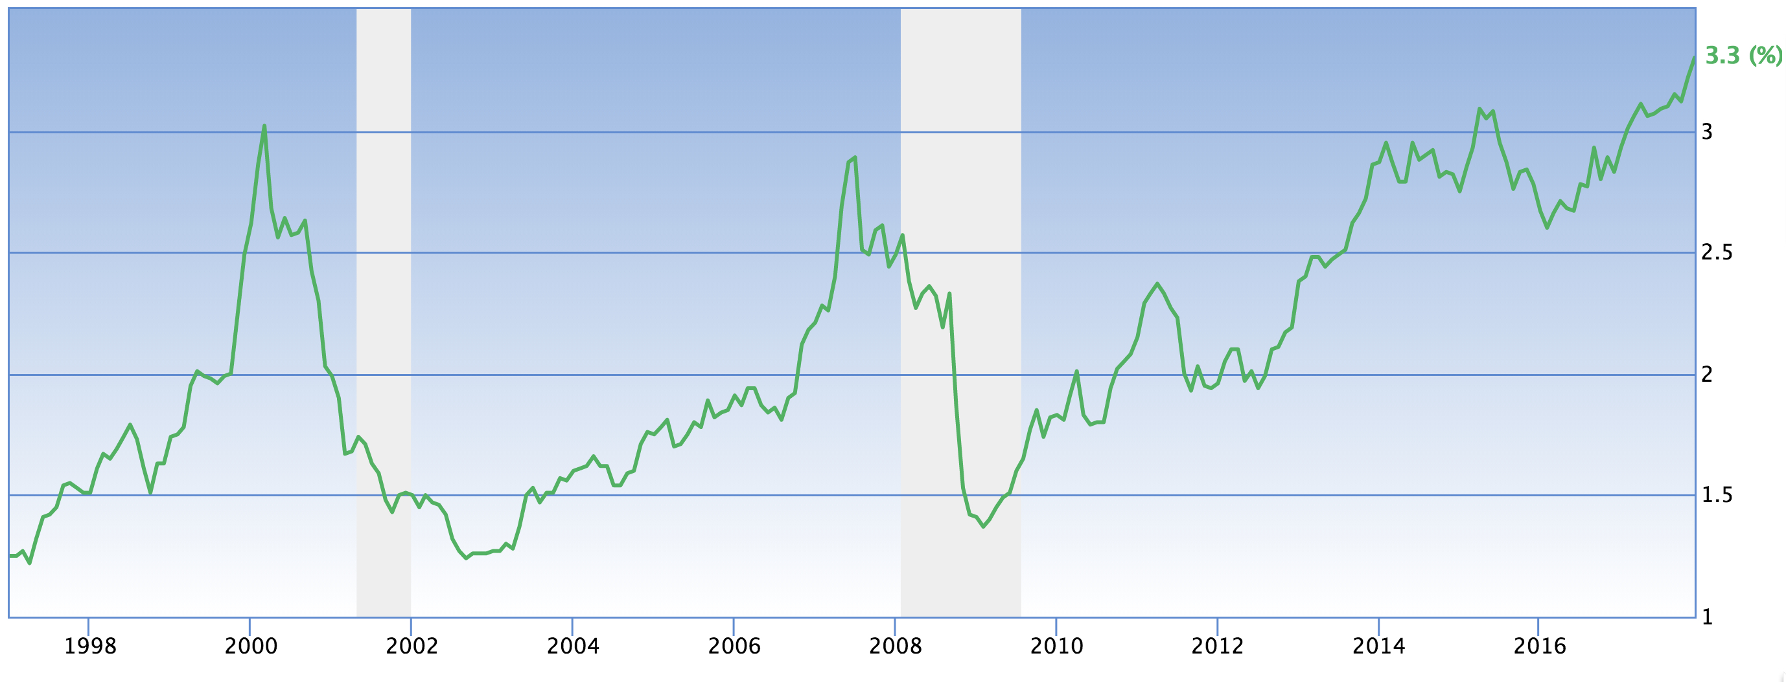
% of GDP Margin Debt is Cyclical and Indicates Possible Recession
Recession
Recession
Recession

Slide 6
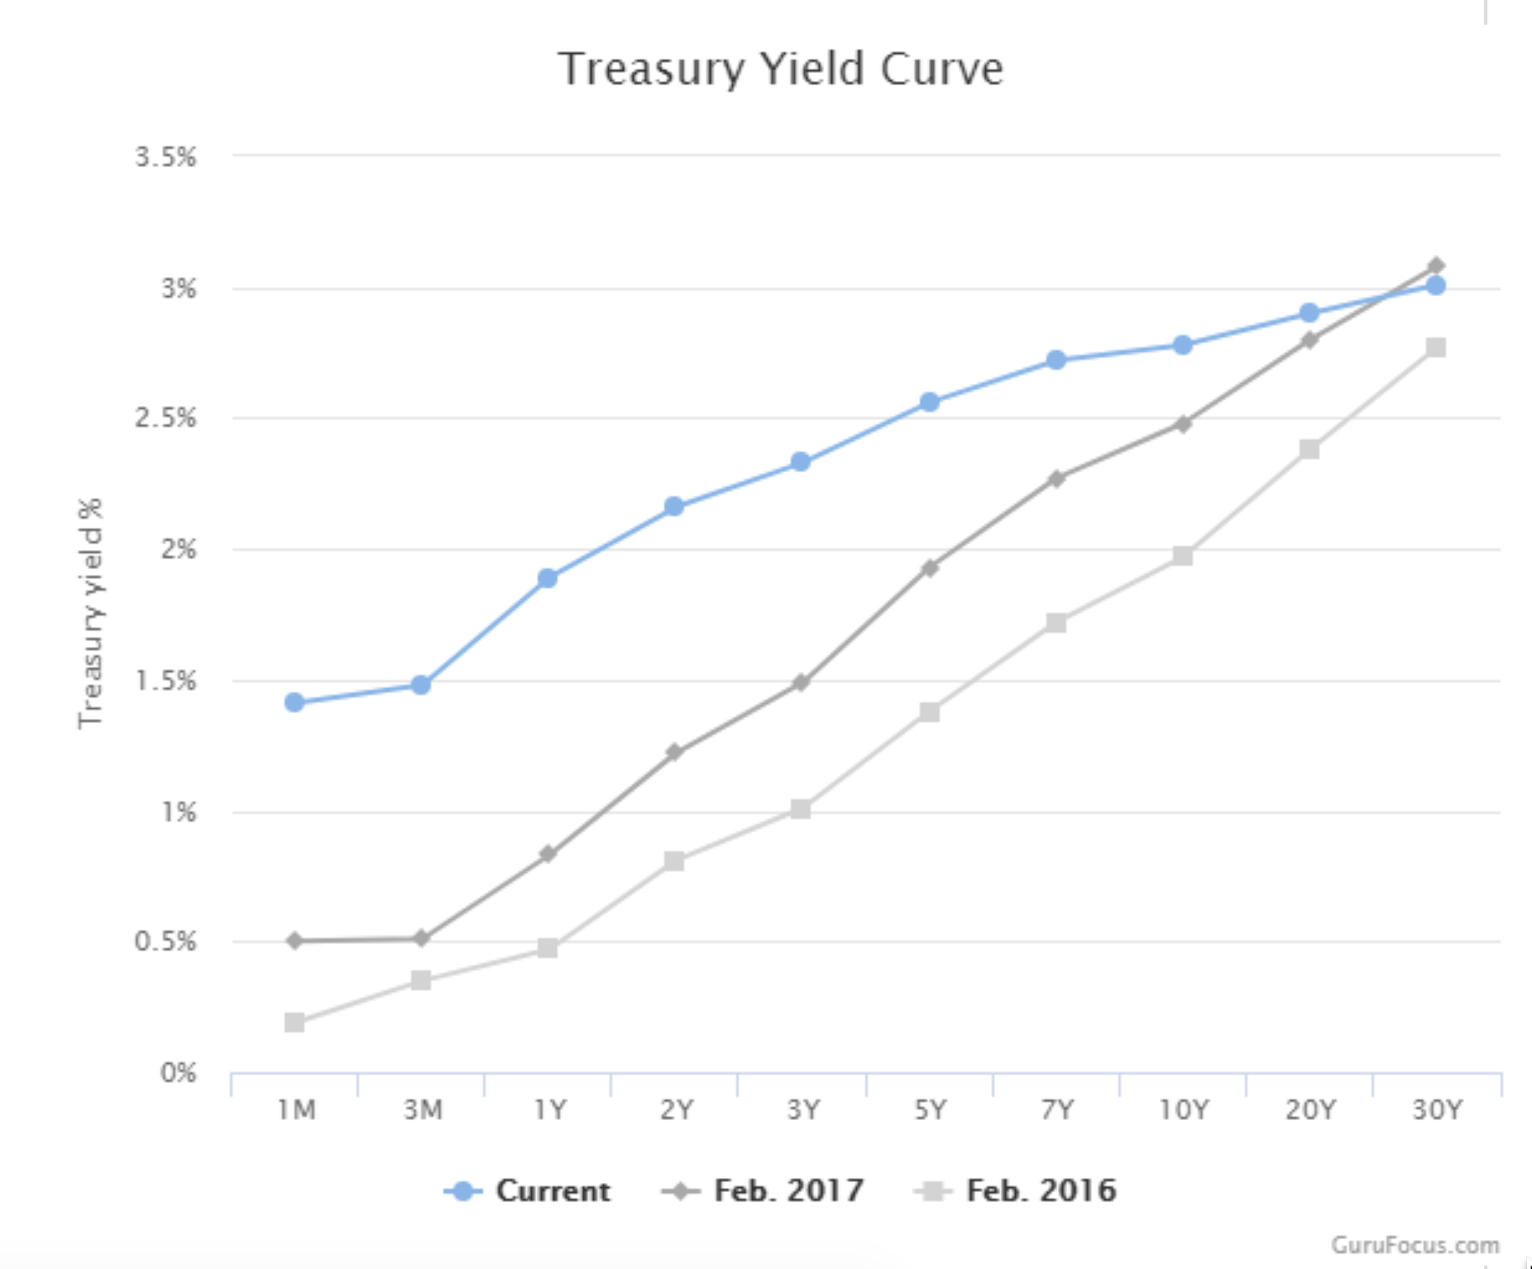
Decreasing Spread in Treasury Yield Suggests Incoming Recession

Slide 7
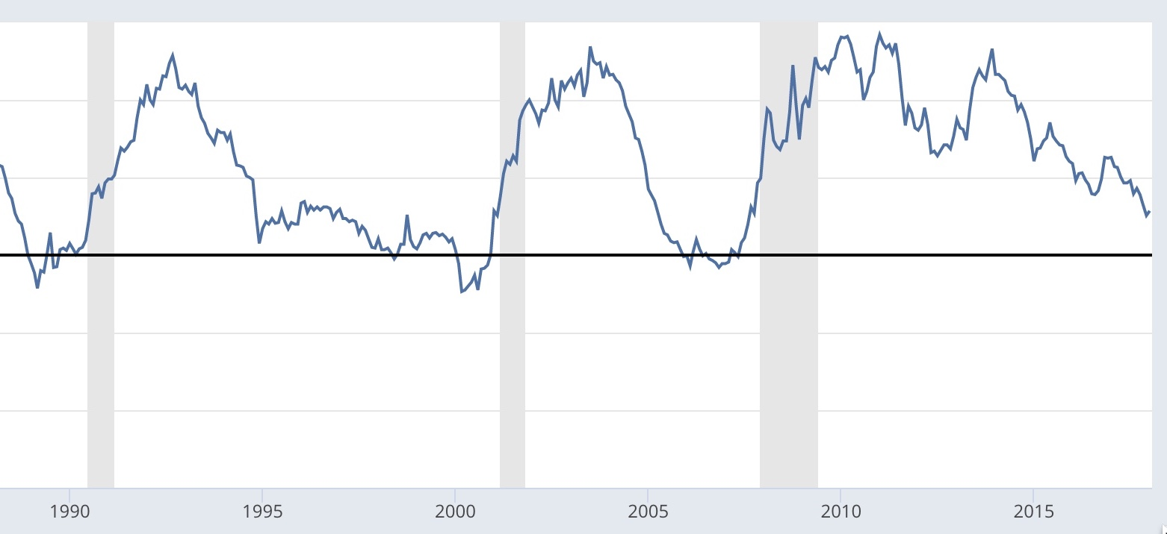
Decreased Spread in Treasury Yield Indicates Recession Prospect
Recession
Recession
Recession

Slide 8
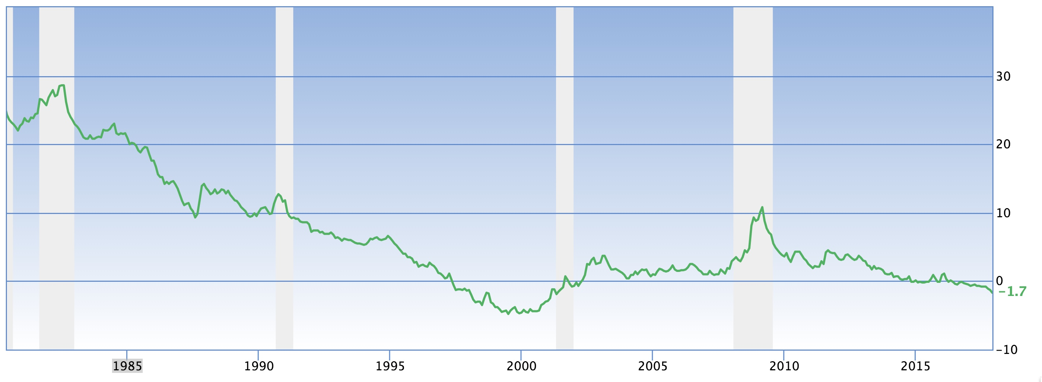
Shiller Stock Market Margins Gains Precede Recessions
Recession
Recession
Recession
Recession

Slide 9
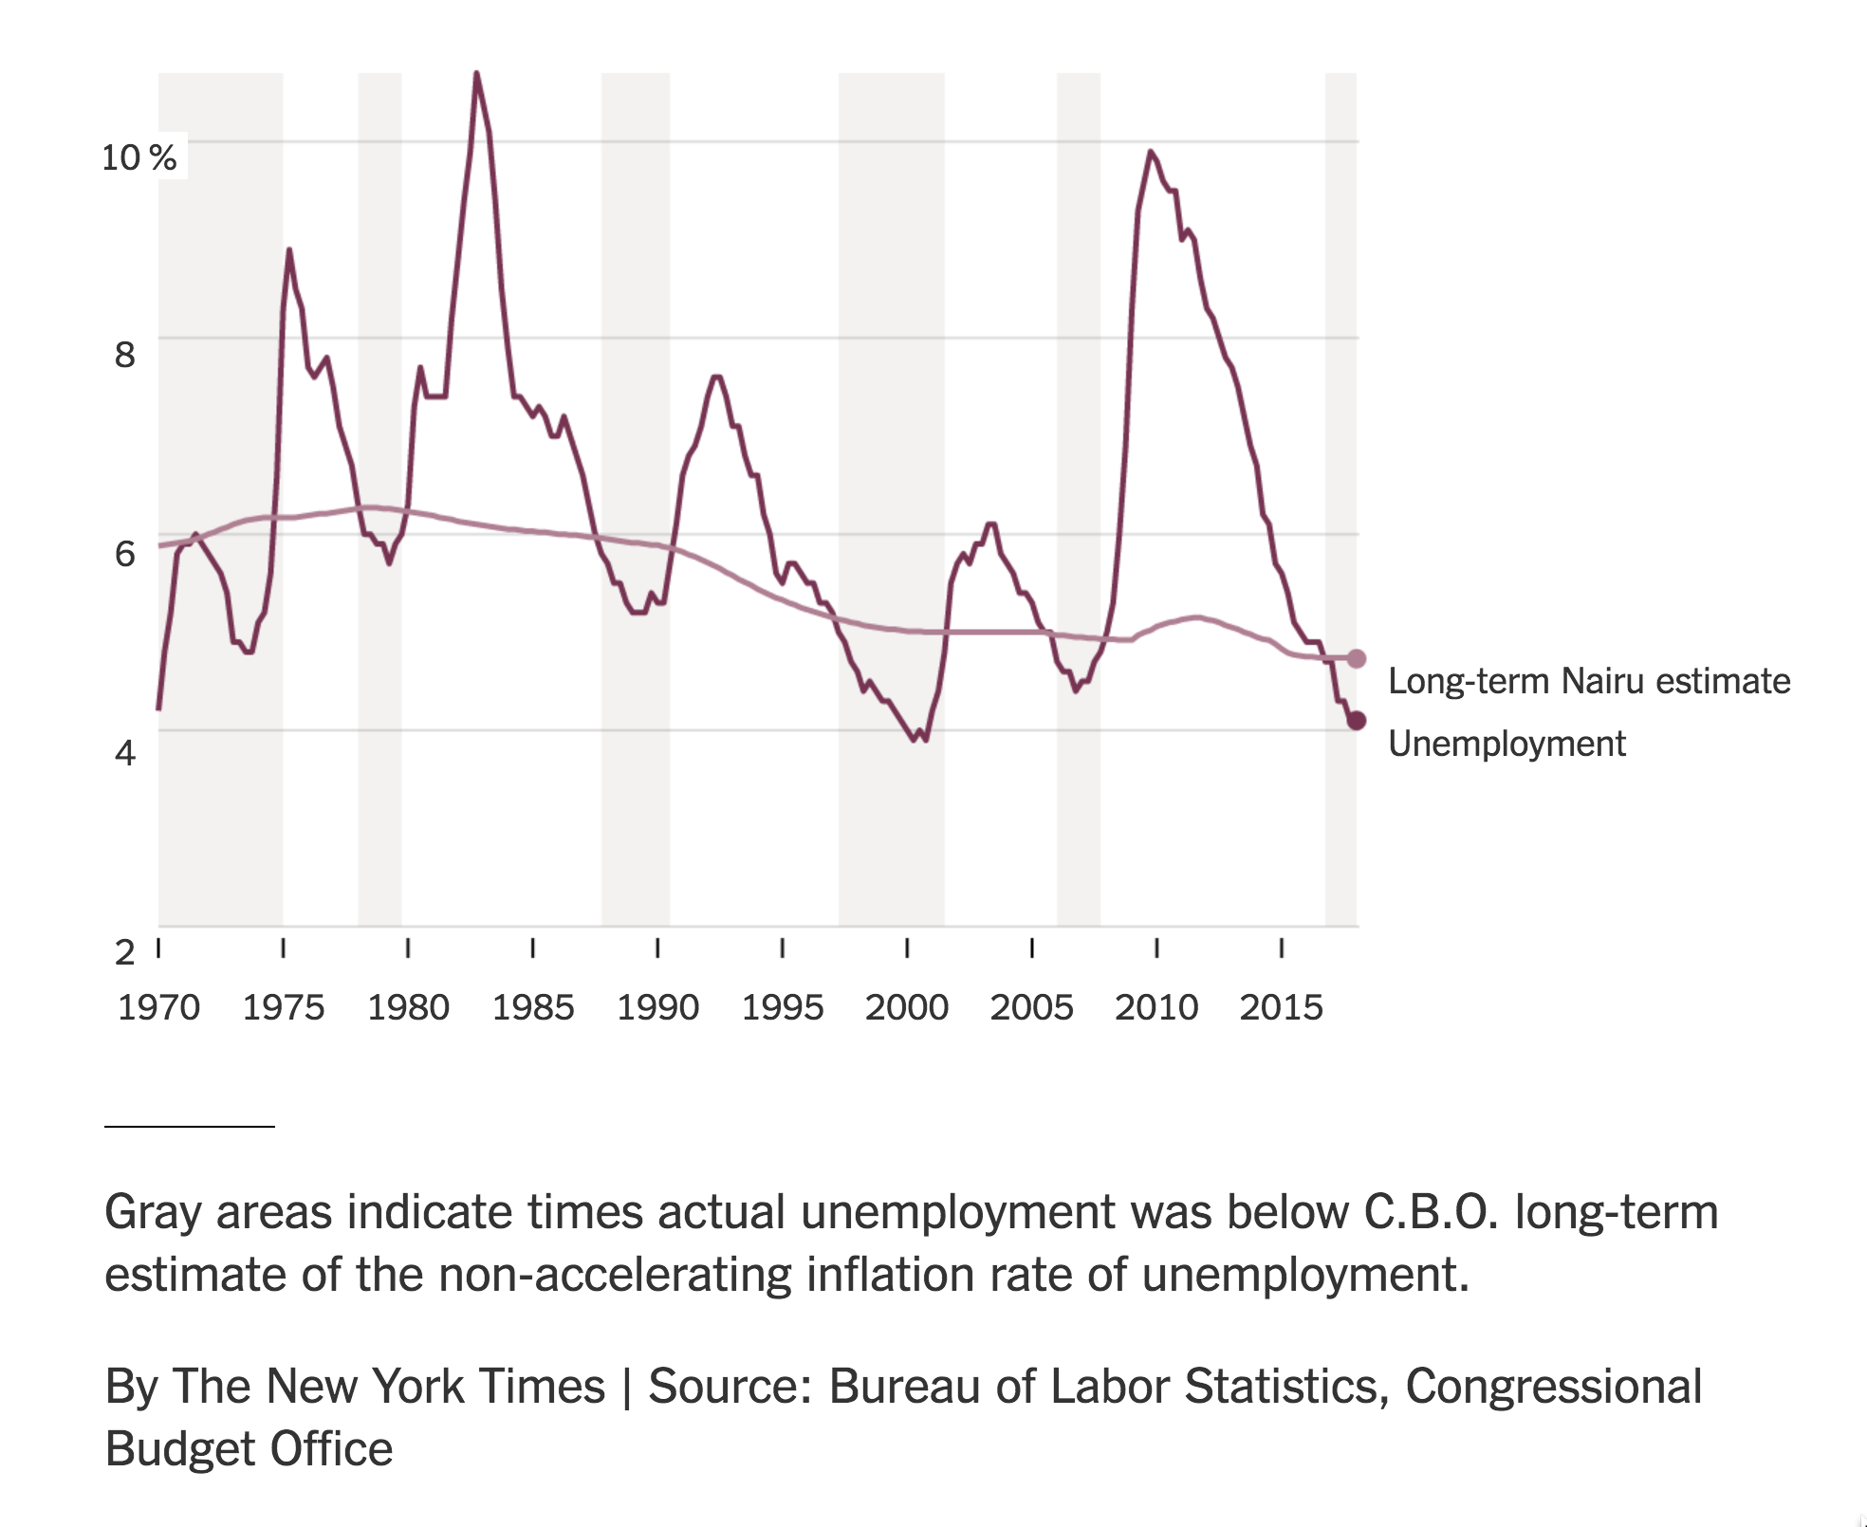
Unemployment Levels Coincide With Recessions
Recession
Recession
Recession
Recession
Recession
Recession

Slide 10
Conclusions
The Stock Market is Significantly Overvalued.
Likely to return of -1.7%/year in the future.
Portfolio Rebalancing Reduces Losses.
Timing of Recessions Possible.

